Slide 1
Obtaining Technology: Implementation
Technology Management

Slide 2
Objective
The specific material examined in this chapter includes:
Reasons to acquire technology
Alliances
Mergers and acquisitions
The importance of goals and due diligence

Slide 3
Strategic Reasons for Mergers or Acquisitions
The merger/acquisition could allow the participating firms to:
Enter a market quickly or increase speed to market
Avoid the costs and risks of new product development
Gain market power
Acquire knowledge

Slide 4
Merger Versus Consolidation
Merger: One firm absorbs the assets and liabilities of the other firm in a merger. In many cases, control is shared between the two management teams. Transactions were generally conducted on friendly terms.

Slide 5
Acquisition
Acquisition: Traditionally, the term described a situation when a larger corporation purchases the assets or stock of a smaller corporation, while control remained exclusively with the larger corporation.
Often a tender offer is made to the target firm (friendly) or directly to the shareholders (often a hostile takeover).
Transactions that bypass the management are considered hostile, as the target firm’s managers are generally opposed to the deal.

Slide 6
Merger negotiations
Friendly Acquisition:
The acquisition of a target company that is willing to be taken over. Usually, the target will accommodate overtures and provide access to confidential information to facilitate the scoping and due diligence processes.
Hostile Takeover:
A takeover in which the target has no desire to be acquired and actively rebuffs the acquirer and refuses to provide any confidential information.
The acquirer usually has already accumulated an interest in the target (20% of the outstanding shares) and this preemptive investment indicates the strength of resolve of the acquirer.

Slide 7
Merger of Equals
While, a merger is the joining of two existing companies into one legal entity, rather than remain separately owned and operated. Also, this action is known as a merger of equals.
For example, both Adell networks and Glob computers ceased to exist when the two firms merged. However, a new company, Adell Glob will be created. Also, Both companies’ stocks will be surrendered and new company stock will be issued in its place.

Slide 8
Strategic Reasons for M&A
Enter a market quickly or increase speed to market
Avoid the costs and risks of new product development
Gain market power
Acquire knowledge

Slide 9
Types
Horizontal Mergers
- Between competing companies
Vertical Mergers
- Between buyer-seller relation-ship companies
Conglomerate Mergers
- Neither competitors nor buyer-seller relationship

Slide 10
Horizontal Merger
A horizontal merger occurs when two companies operating in the same market (and selling similar products or services) come together to dominate market share. This type is attractive for merging companies aiming to build economies of scale and decrease market competition. However, there are potential downsides. A horizontal merger comes with increased regulatory scrutiny and stringency, and can lead to a loss of value if the post-merger integration is not fully realized. Regulatory due diligence should be executed with extra special care.

Slide 11
Facebook and Instagram
One of the most definitive examples of horizontal integration was the of Instagram by Facebook (now Meta) in 2012 for a reported $1 billion.¹
Both companies operated in the same industry (social media) and shared similar production stages in their photo-sharing services.
Facebook sought to strengthen its position in the social sharing space and saw the acquisition of Instagram as an opportunity to grow its market share, reduce competition, and gain access to new audiences. Facebook realized all of these through its acquisition. Instagram is now owned by Facebook but still operates independently as its own social media platform.

Slide 12
Vertical Merger
Vertical mergers involve two companies in the same industry who operate in different stages of production. This could involve a retailer who merges with a wholesaler, or a wholesaler merging with a manufacturer, for example. This type of merger is ideal for streamlining operations, boosting efficiencies, and cutting costs across the supply chain, but it can also reduce flexibility and result in new complexities for the business to manage.

Slide 13
eBay and Paypal
A classic example of a vertical merger would be between eBay and PayPal in 2002. eBay is an online shopping and auction website, and PayPal provides services to transfer money and allow users to make online payments. Though both eBay and PayPal were operating in dissimilar businesses, the merger helped eBay to increase the number of transactions and proved a strategic decision overall.

Slide 14
Conglomerate Merger
Unlike the other types of merger, a conglomerate merger occurs between two companies whose business activities and industries may be completely unrelated. In pure conglomerate mergers, the two firms may continue to operate separately within their own markets, whereas in a mixed one, they may look to expand product or market reach. While this type of merger can help the new entity increase market share and diversify its business, it can be especially challenging to integrate dissimilar companies, raising the risk of culture clashes and lost efficiency due to disrupted business operations.

Slide 15
Disney and ABC
Walt Disney Company & American Broadcasting Company merger - this is often cited as a prime example of a conglomerate merger. In 1995, Disney purchased ABC, gaining entry into ABC’s national television realm, as well as ESPN’s extensive sports coverage. Since Disney already owned several cable networks at the time of the deal this would be a mixed conglomerate merger because it did open up extensive new distribution and content options for Disney.

Slide 16
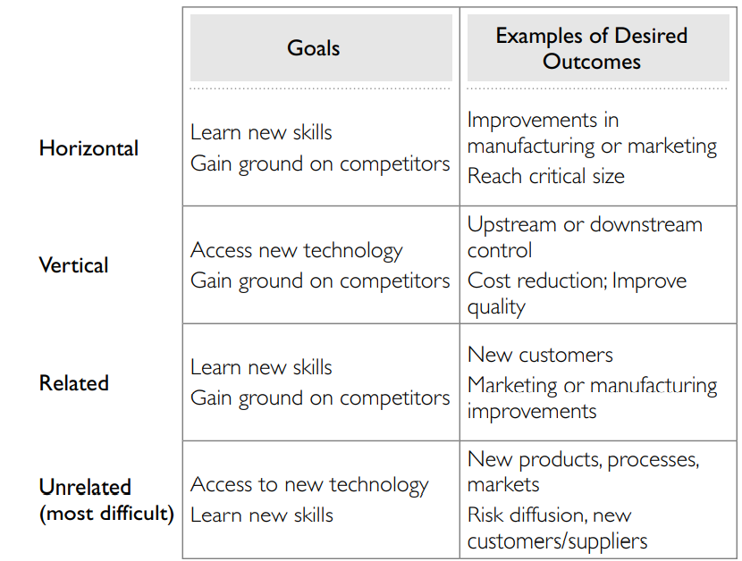
Types of Mergers

Slide 17
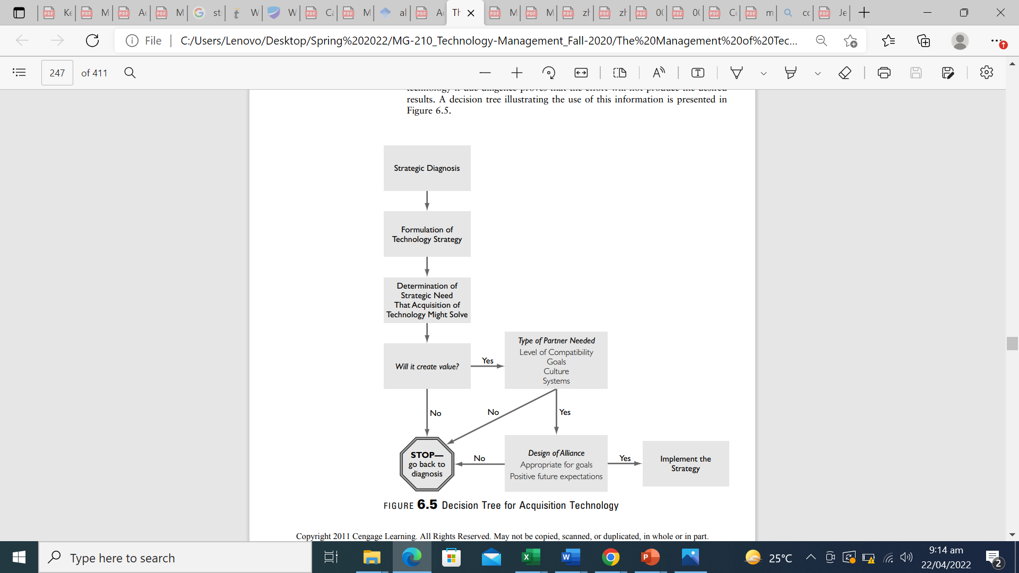
Decision Tree for Acquiring Technology

Slide 18
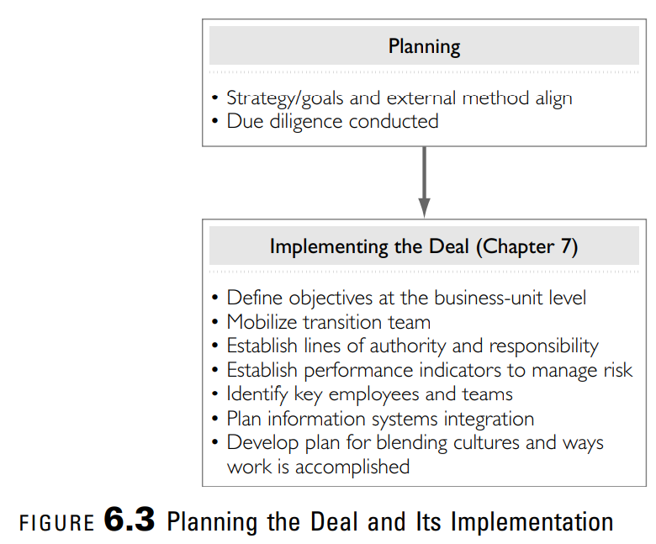
M&A Process

Slide 19
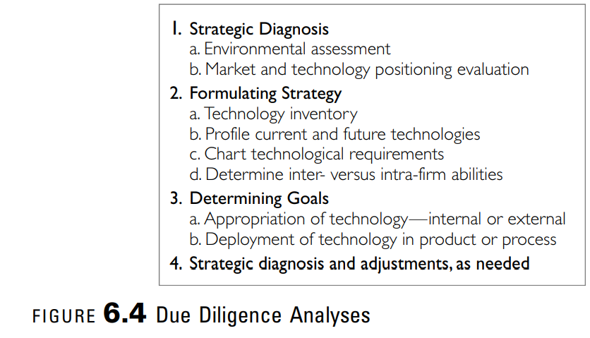
Due Diligence

Slide 20
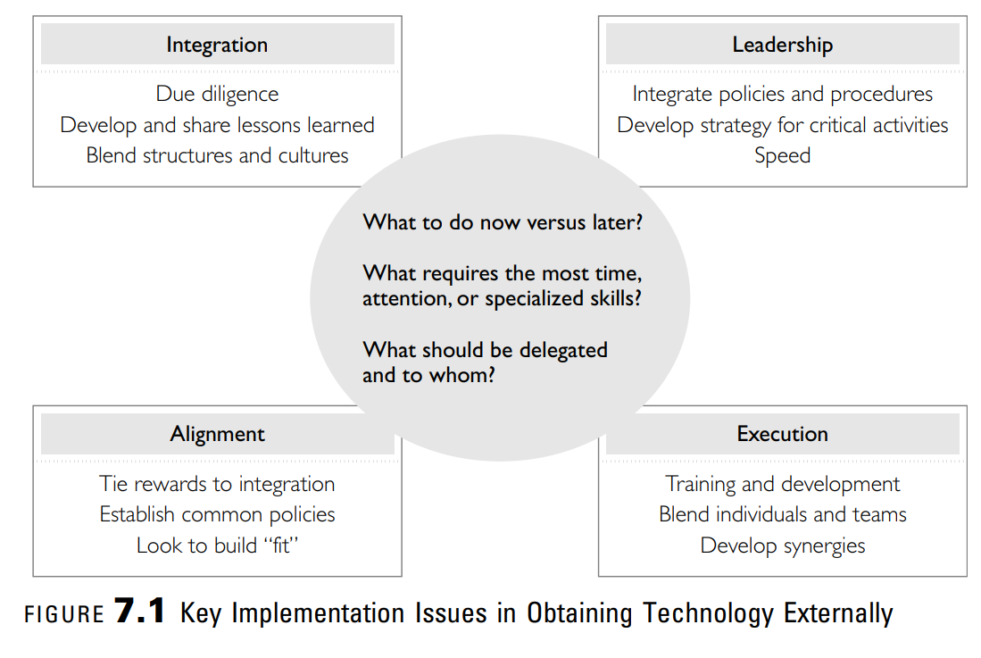
Key Implementation Issues

Slide 21
Integration
Blending or creating fit within an organization, whether it is an alliance, joint venture, or merger/ acquisition, requires developing shared norms, capturing competencies from both organizations, creating compatible systems and structures, and integrating teams and functions.

Slide 22
Example - Cisco
For the Integration of the acquired system includes:
Strong due diligence prior to acquisition identifies all potential issues and problems as well as critical differences in the acquired firm.
One-third of top management from the acquired firm fills slots in the new unit.
A buddy system matches key employees of the acquired firm with key employees in Cisco.
Customization of each integration effort matches the unique needs of the firm.
Conversion of existing systems, such as computers, to Cisco systems takes advantage of economies of scale.
Ninety days are allocated to complete integration of the acquired firm into Cisco.
Notes:
Cisco was founded in 1984. Between 1989 and 1999, the firm had a compounded growth rate of 89 percent per year. In 2008, the firm targets a more moderate but still impressive 12-17% annual growth. The firm in fiscal year 2008 had sales of $39.5 billion. Much of this growth came through acquisitions based on Cisco s clear strategy to gain competitive advantage through the acquisition of new technology. Cisco s continued success depends on those acquired firms being integrated into the parent firm. As a result, Cisco has a well-established system that it follows for the acquisition of technology and technology-focused firm.

Slide 23
Integration
Three critical elements in integration include:
Blended structures and culture
Due diligence
Shared lessons

Slide 24
Unrelated Merger/Acquisition
in an unrelated acquisition, restructuring is often required. This could mean a new strategic business unit or a new division is formed to house that technology. The formation of a separate unit requires less integration.
But, in related acquisitions, there is usually much more integration, and the integration is far-reaching to the individual and team levels. The amount of cultural change needed or expected is usually more extensive and based on several other factors: size of the merging entities, strength of the culture, and criticality of the knowledge each brings to the blended firm.

Slide 25
Organizational Culture
For the blended firm, the culture usually takes on one of four forms:
Separate cultures: The resulting firm maintains the separate cultures of the original firms. This usually emerges with unrelated acquisitions and with the acquisition of a firm that is large enough to be its own division or SBU within the integrated firm.
Dominant culture: This occurs when two entities merge and one has a very strong culture or is much larger. Usually, the larger firm is the dominant culture; however, if the reason for acquiring external technology is to change the direction of the firm, a smaller firm with a strong culture may influence the new entity much more. In this case, the CEO of the smaller company is usually the CEO of the blended firm.

Slide 26
Organization Culture
3. Multiple cultures: Subcultures exist within all firms of any size. A firm with multiple cultures allows the merging entities to keep their cultural norms and blends them to a smaller degree than with the new culture approach. This can be successful, especially in firms with divisional or SBU structures. The danger here is that the systems and processes in each area can easily evolve to levels of incompatibility. Then the differences in culture can create more friction in trying to change and integrate the systems. This type of culture usually emerges when a large firm with multiple unrelated businesses acquires multiple entities a holding firm.

Slide 27
Cultural Differences
Cultural differences occur at three different levels: individual differences in experiences (history or functional background), the cultures of the firms involved, and country culture.

Slide 28
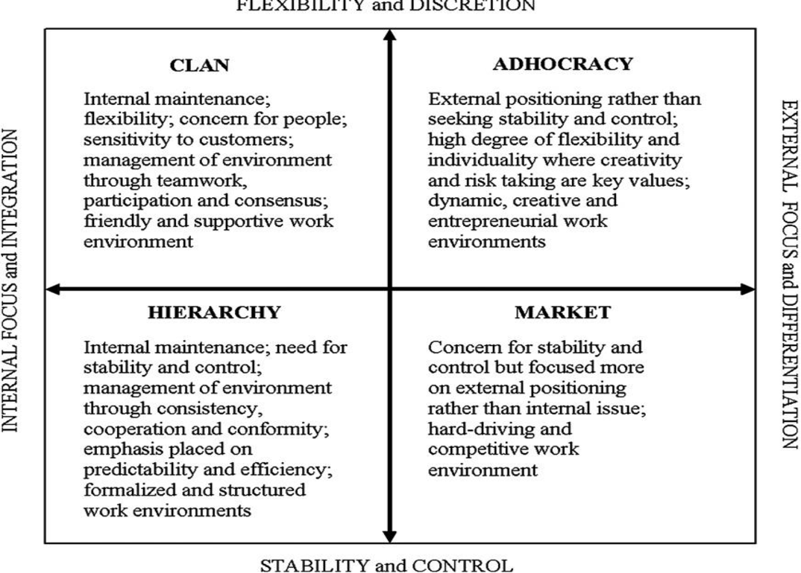
Organizational Culture Types

Slide 29
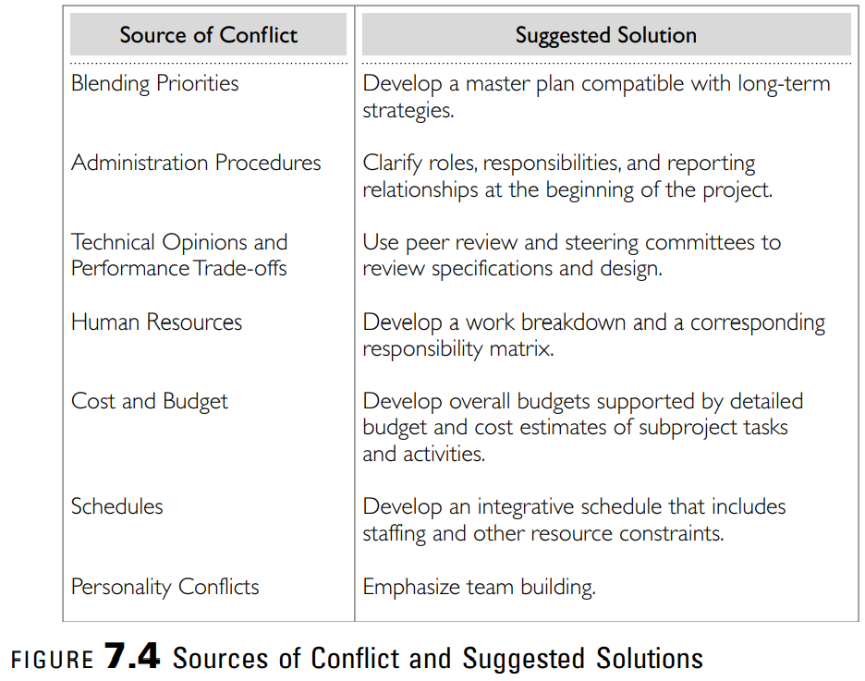
Blend Individuals and Teams

